Slide 1
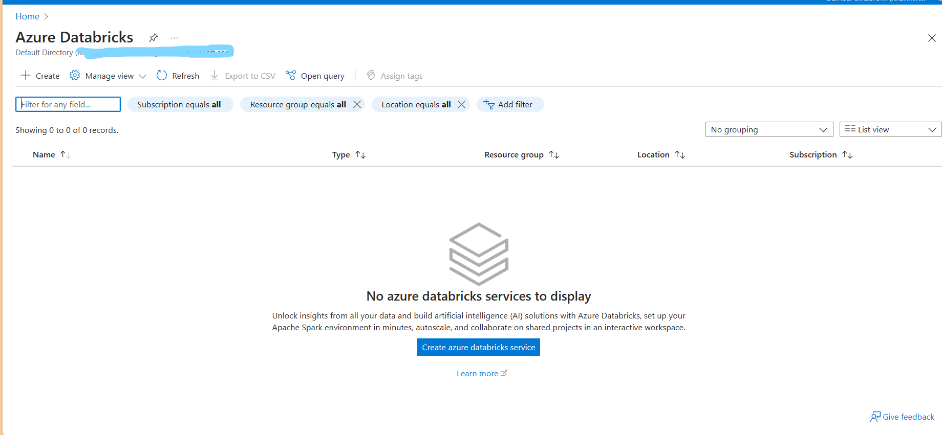
Create Azure Databricks service

Slide 2
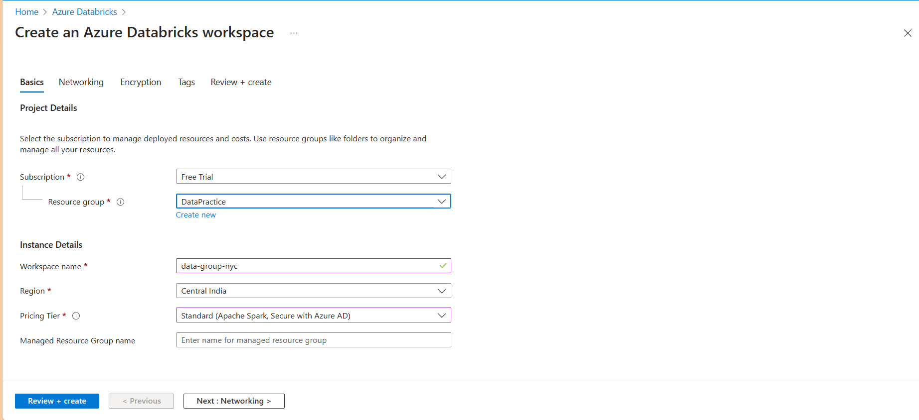
In Home search for Databricks
Select data bricks
Click on create

Slide 3
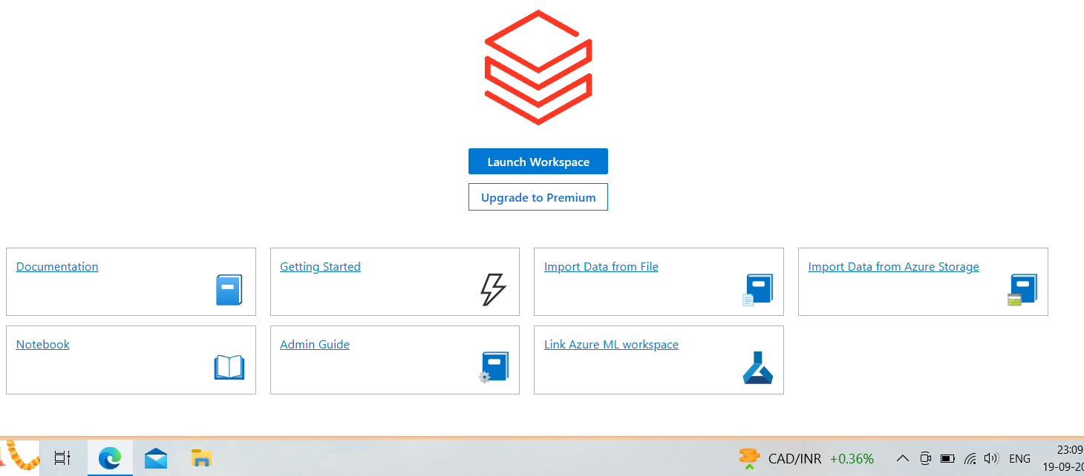
In overview
Click on launch workspace to launch data bricks workspace
But before launching it
Lets assign role to user to perform operation on top of it

Slide 4
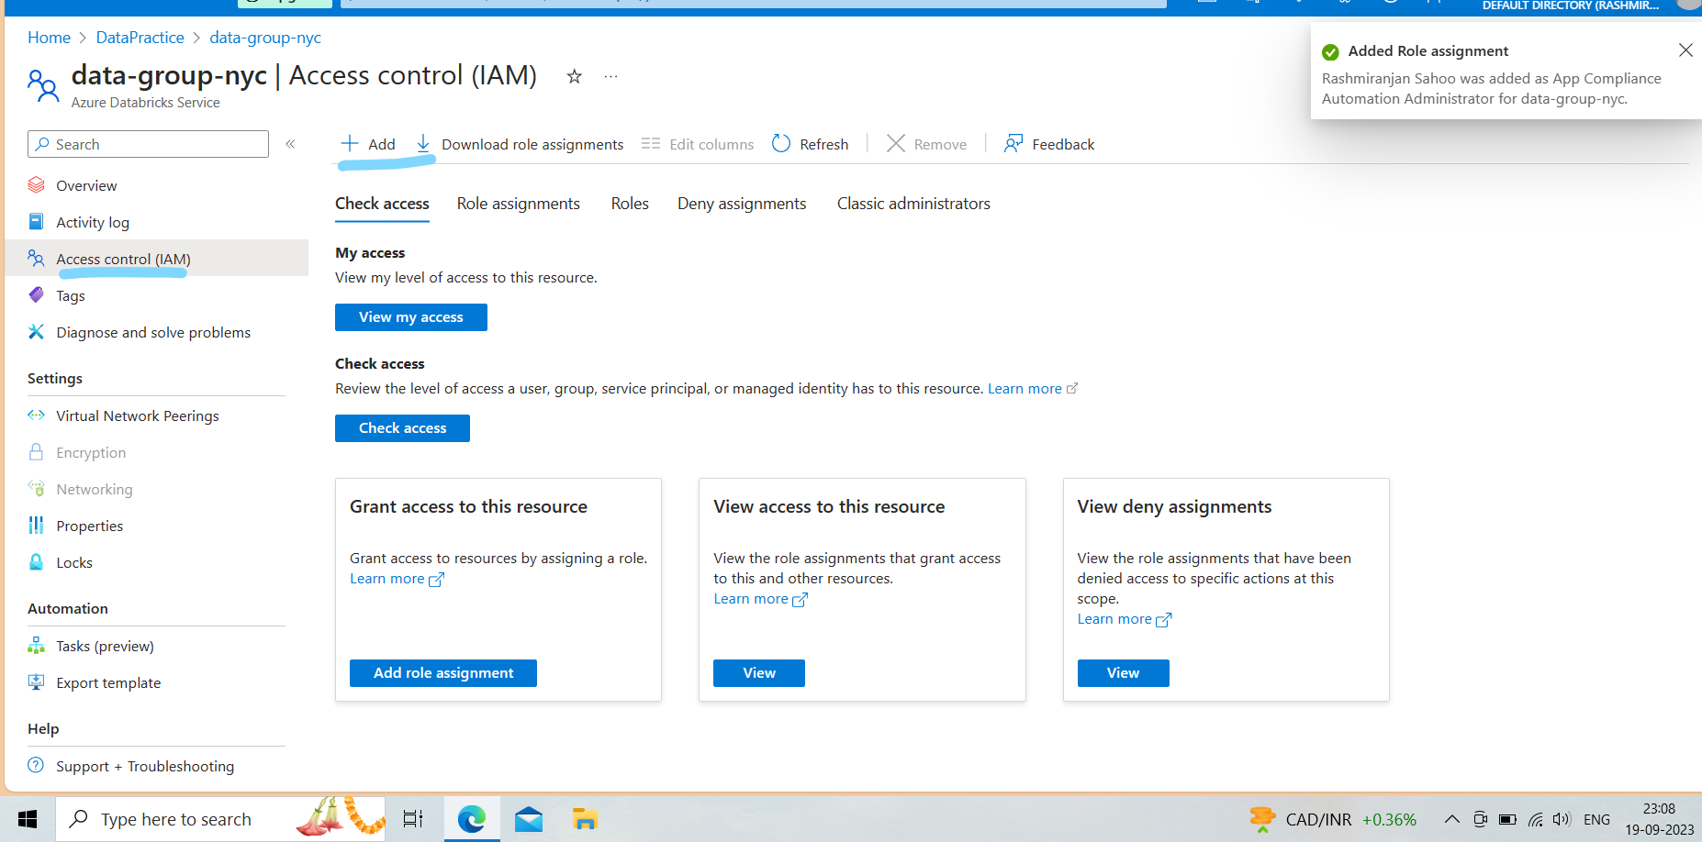
Click on access control (IAM)
+ add , select role ,next, +member ,choose user

Slide 5
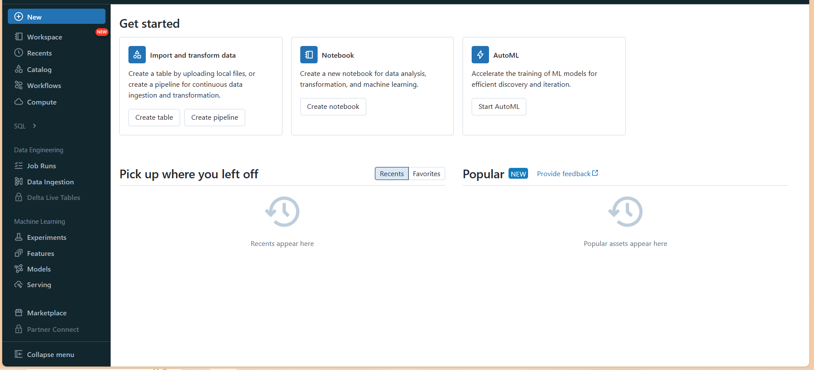
click on launch workspace in overview
It open new tab with azure data bricks

Slide 6
Click on compute to create cluster
Cluster name
Cluster mode
Standard
High concurrency
These above 2 are types of cluster
Standard for single user
High concurrency for multiple user
Selecting standard
Choose runtime version
Here Scala is a language framework
Spark is a processing framework
Enable autoscaling
Terminate after 120 minutes of inactivity
Worker type select one
Set min worker
Max worker
These min worker and max worker help us in autoscaling
Driver type
Same as worker
Create Compute

Slide 7
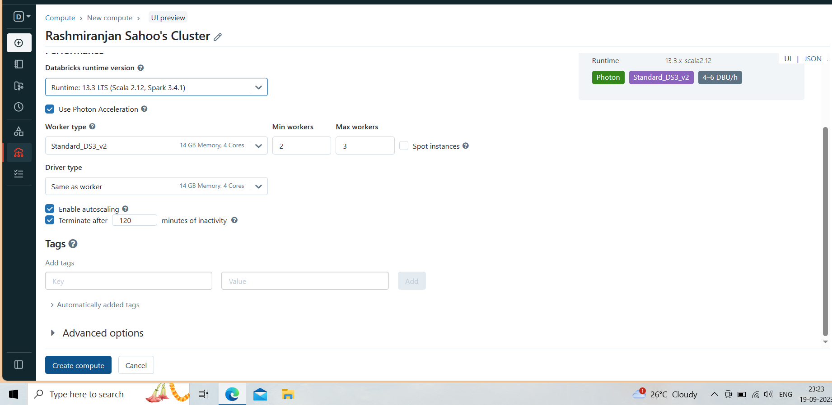
Cluster setup

Slide 8
Its my bad , on the next day my free tier subscription expires in azure
To complete this I am going to use data bricks community edition
And need to create a sql server connect that with power bi
But if we do in azure
We don’t need sql server to connect power bi,
We can direct connect with azure data lake gen2
There is a connector available
And also I have to manually upload data in dbfs in community edition
Rather mounting
But I will show that how to mount it

Slide 9
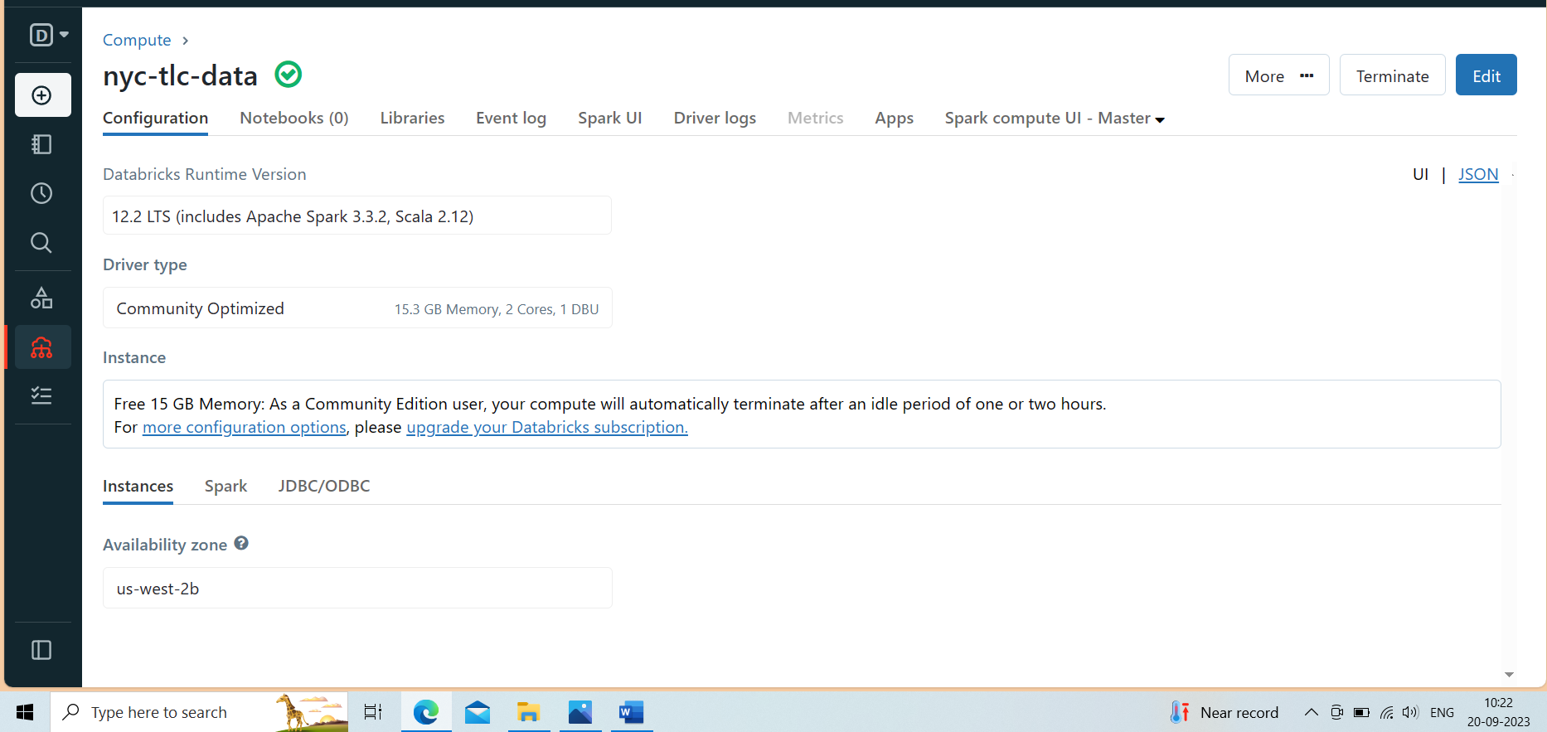
Creating a cluster in data bricks community edition

Slide 10
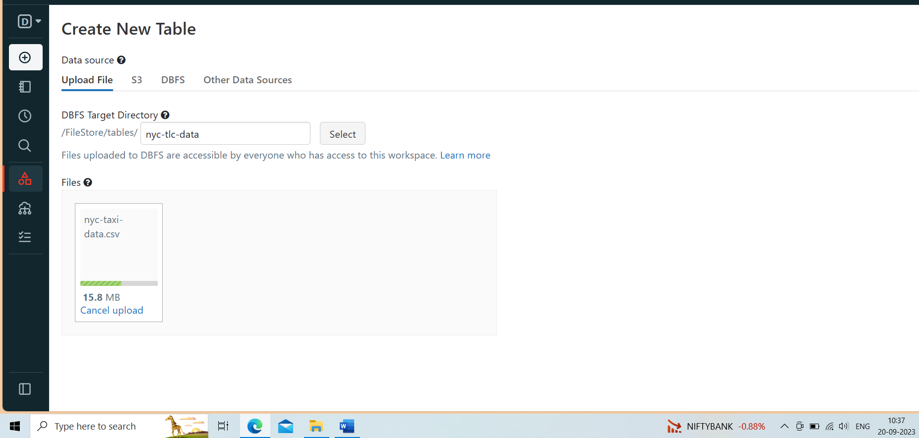
Upload data into DBFS
Click on data click on create table click on select browse file upload

Slide 11
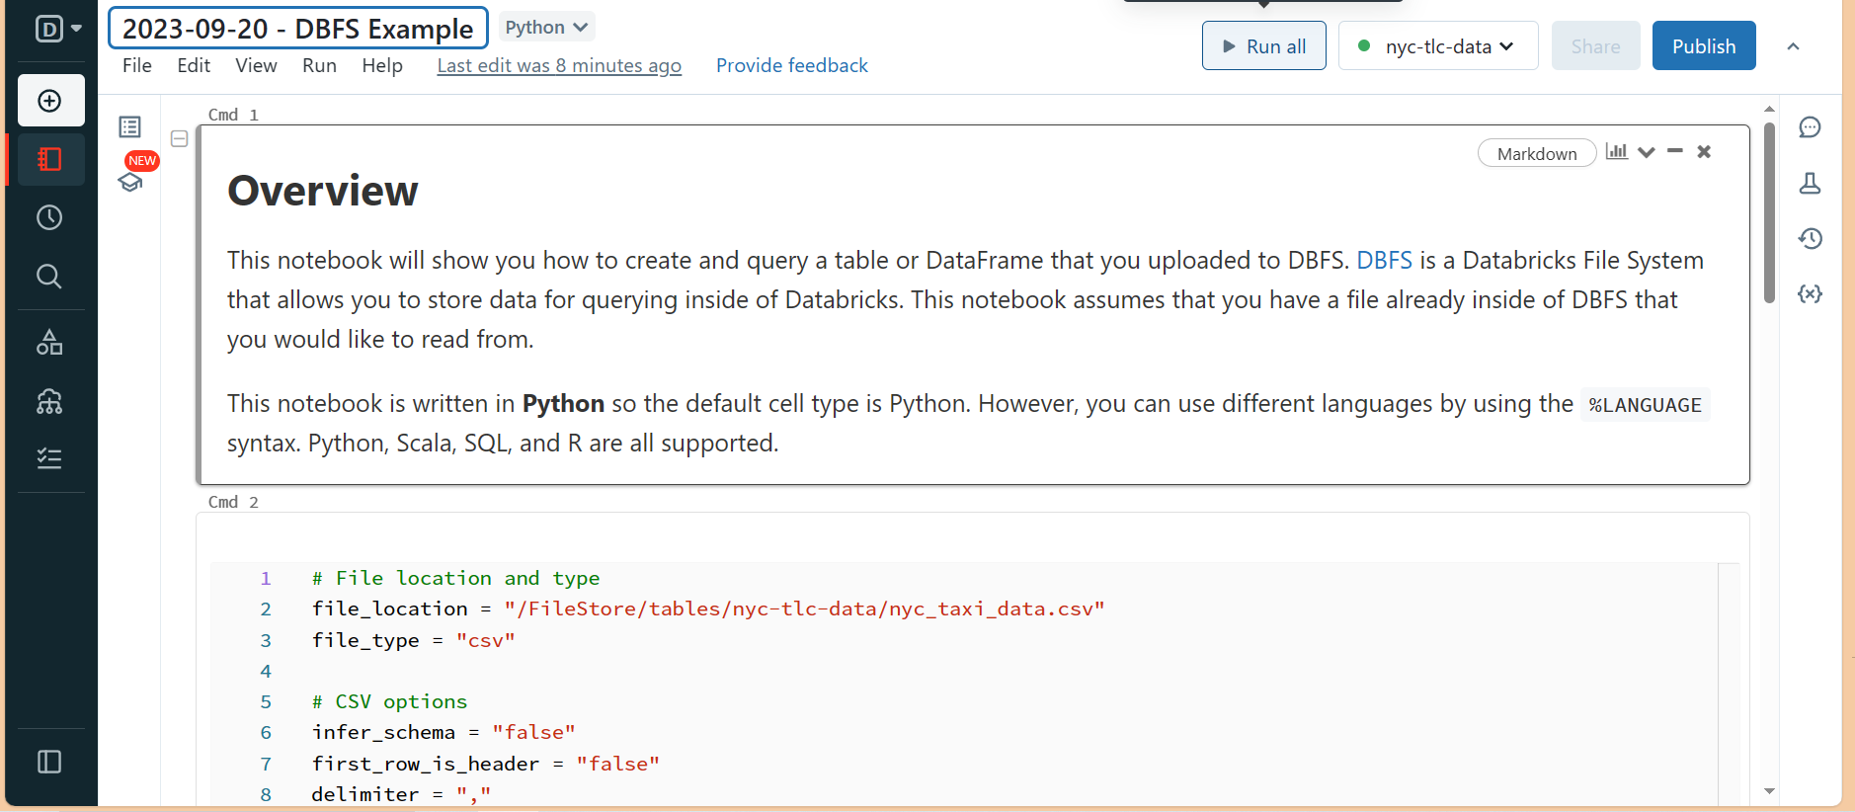
After uploading data successfully
There will be a option available in below
Create table with UI
Create table with notebook
Click on create table with notebook
It will generate a note book
Then we can rename it
Connect with cluster to run it

Slide 12
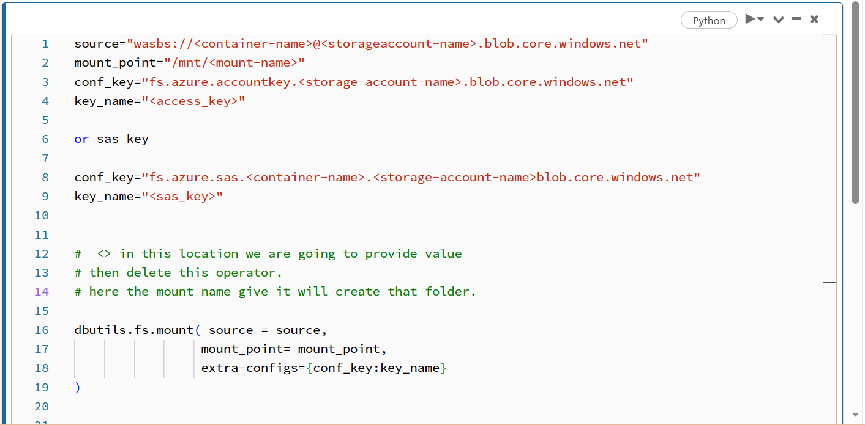
Mount azure data lake gen2 with data bricks
After mounting click on mount name it will open filesystem hierarchy
Read the csv file from mount point data path

Slide 13
All the etl code available in
Nyc-tlc-data-model(1).ipynb
Here the data we have in denormalized form as stored in organization to save money and utilizing much resource to store lots of data rather process.
We convert this data into normalized by data modeling
Connect that data with power bi and answer business queries.

